Slide 1

Restaurant Review
Summarizer App
-Semi-Supervised Approach-
Renkoh Kato

Slide 2
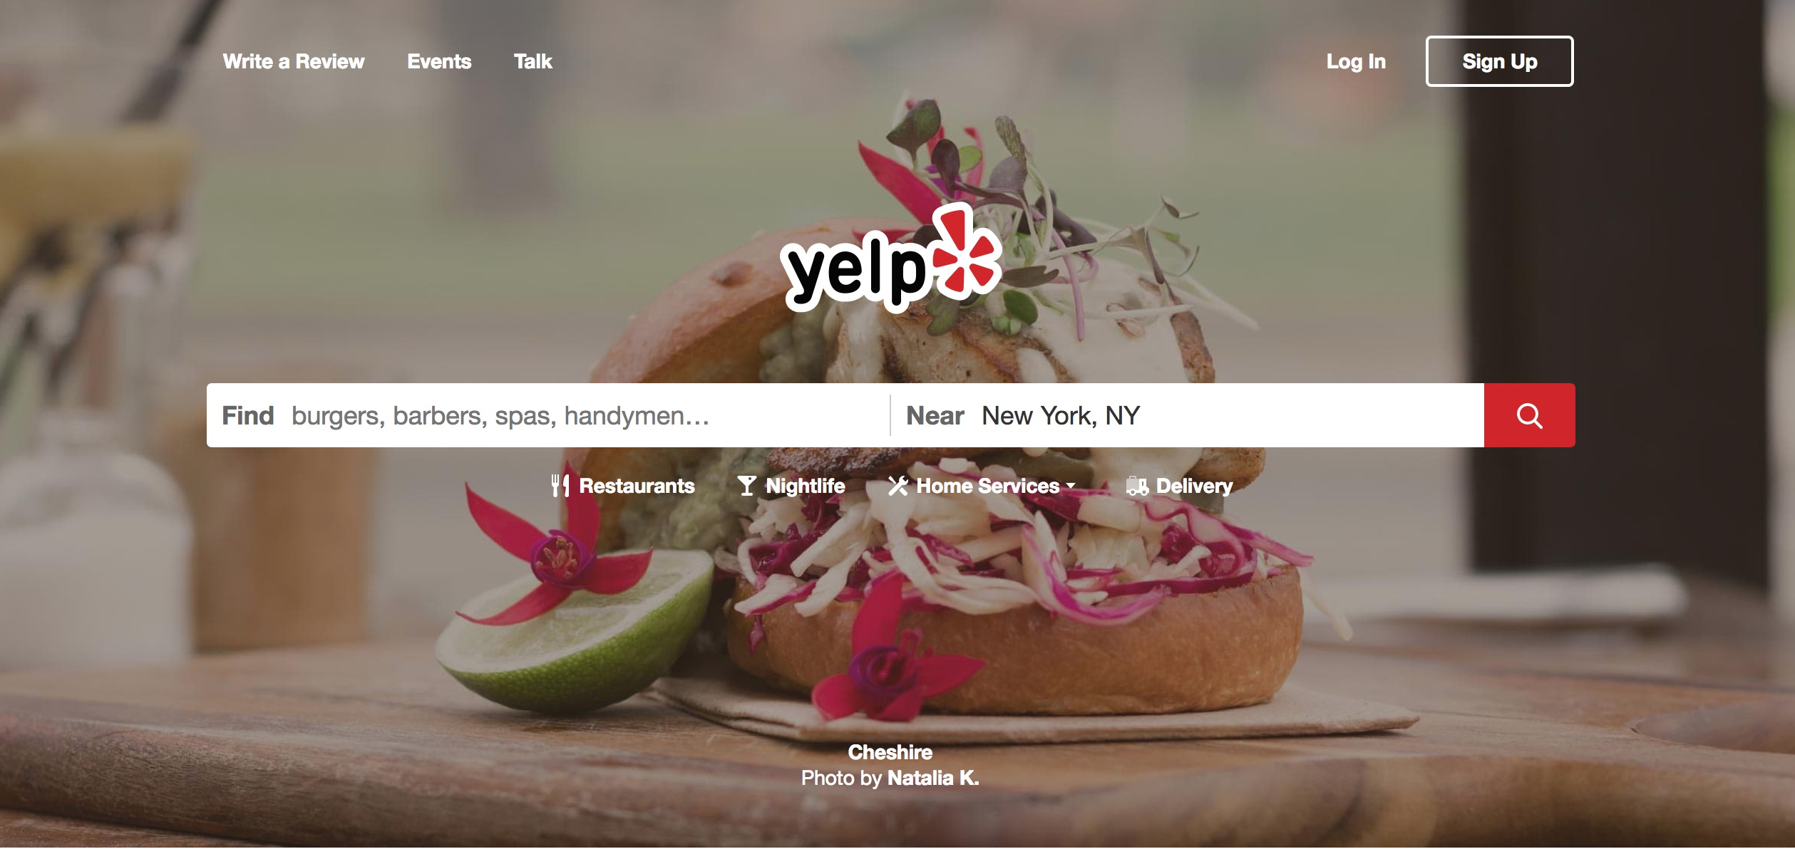
Notes:
crowd-sourced reviews of businesses:
restaurants, doctors, venues, etc.

Slide 3
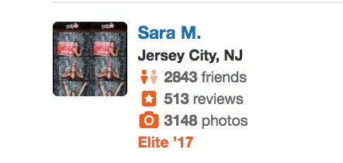
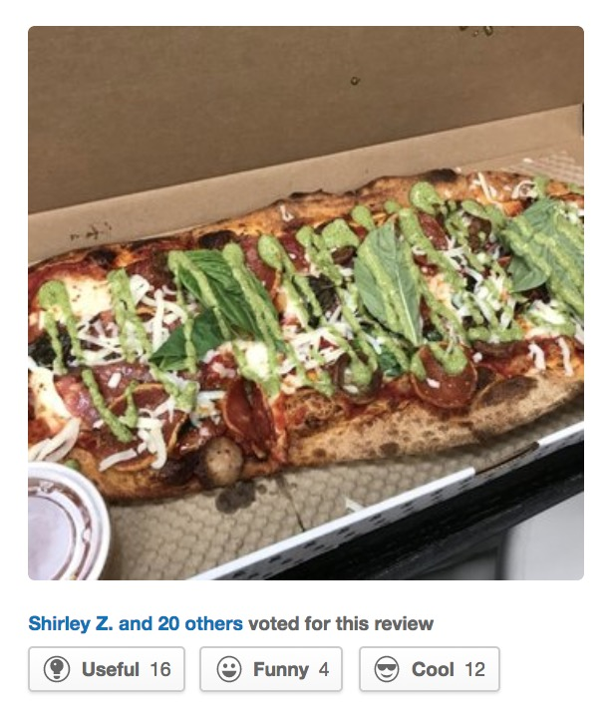
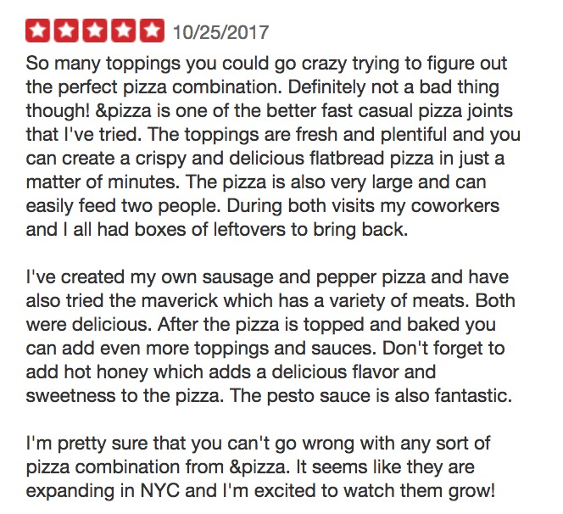
Sample Review
&PIZZA

Slide 4
Sentence Count Distribution
Median - 11 sentences
Max - 100 sentences!!
%Dist
????
0
20
40
60
80
100
Number of Sentences in Review

Slide 5
Can I summarize
Yelp reviews?

Slide 6
Why?
focus on the most useful comments
digest information quickly
make informed decisions

Slide 7
Dataset
Yelp Open Dataset
~5M reviews
Restaurant reviews only
~750k reviews

Slide 8
Topic Modeling
UNSUPERVISED
Topic Modeling - LDA
Reviews are analyzed at sentence level
Topic weights aggregated at Review level (avg)
LDA Weights
(12 Topics)
Review Level

Slide 9
Model Development - Logistic Regression
Features
LDA Topic Weights
Review Sentiment
Length of Review, etc.
Binary Target
Review is ‘Useful’
vs ‘Not Useful’
(voting system)
ROC: 0.70

Slide 10
Review Summarizer App (Flask)
Yelp
Review
Predict Usefulness (sentence level)
Return most important sentences
(default 5)

Slide 11
DEMO

Slide 12
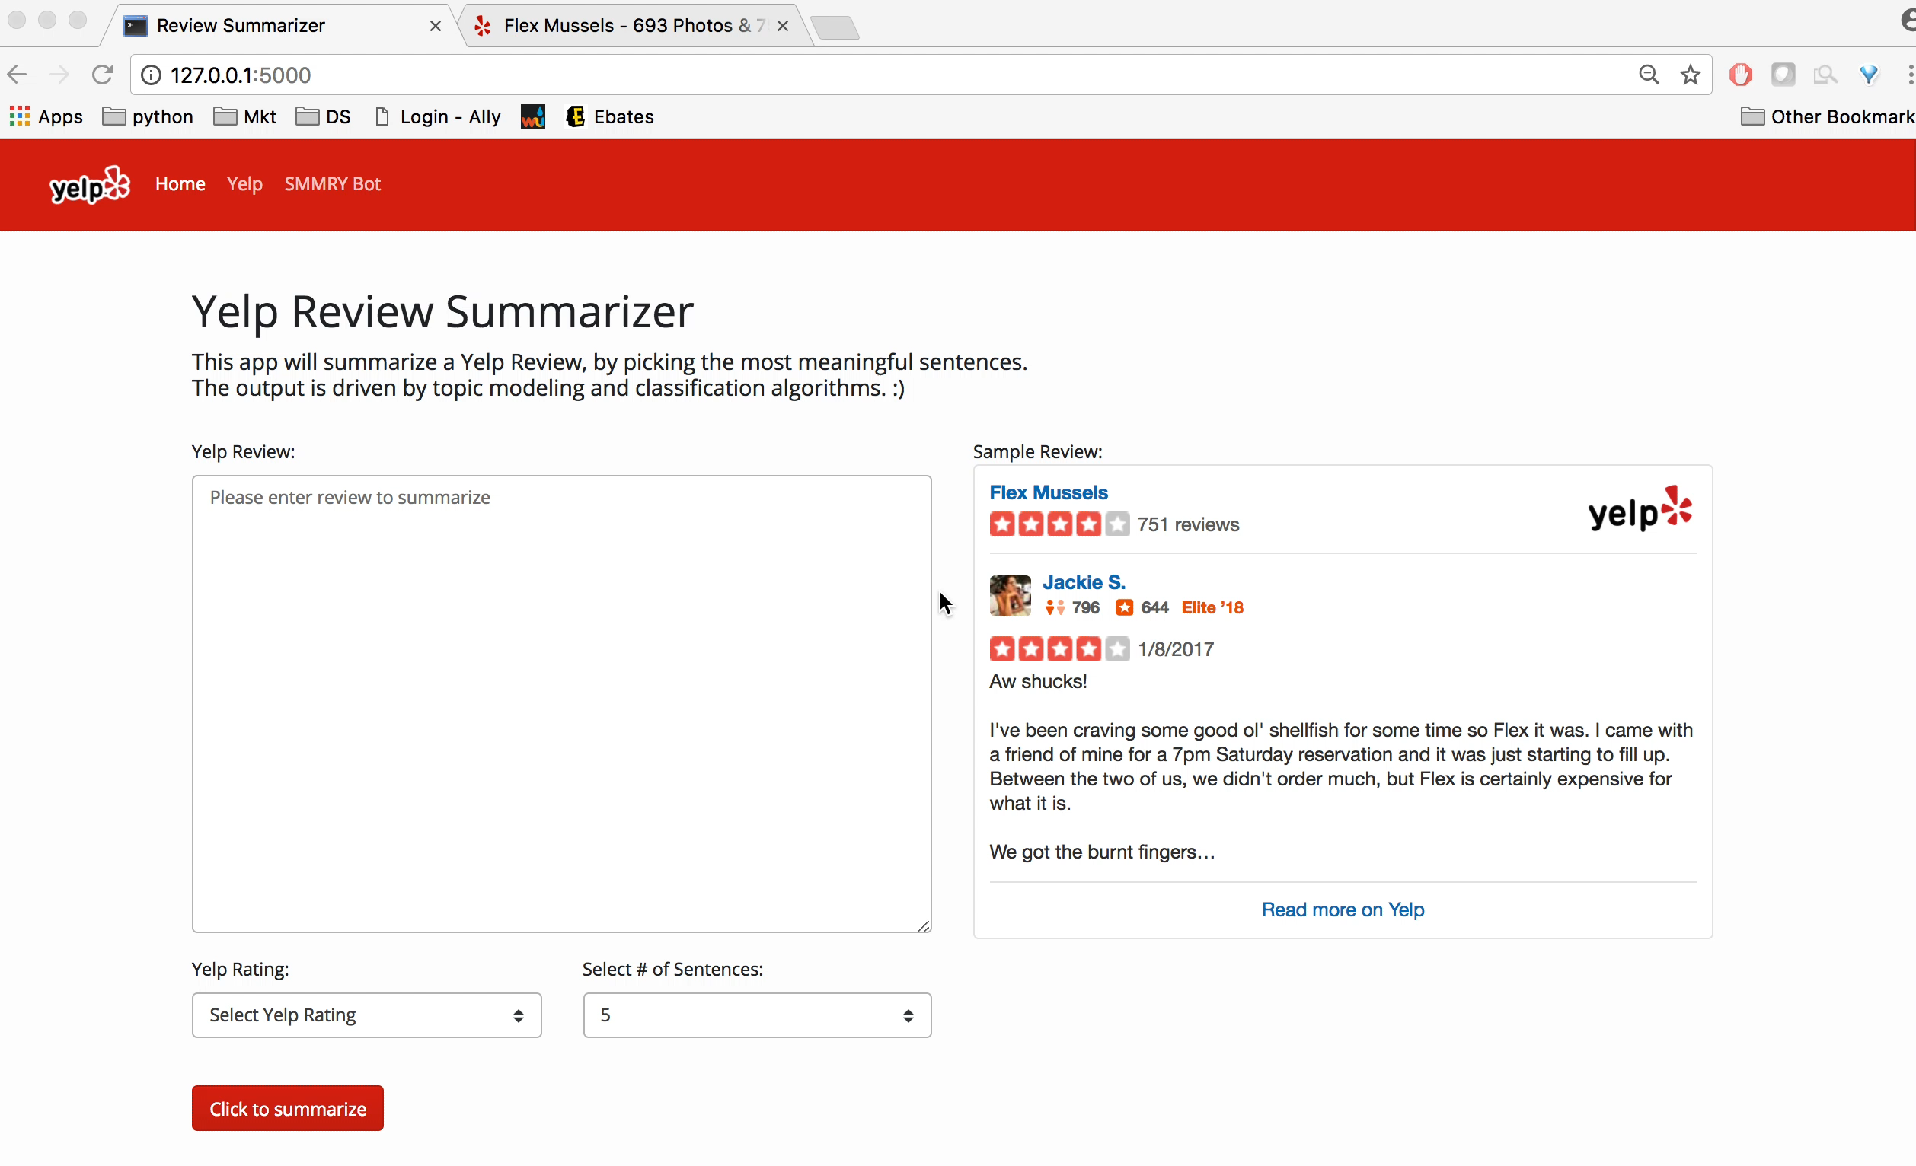

Slide 13
Final Thoughts
fine tune algorithm
extend to other types of reviews
summary + topic tagging
additional use cases
news articles
blogs

Slide 14
Thank You!

Slide 15
Appendix

Slide 16
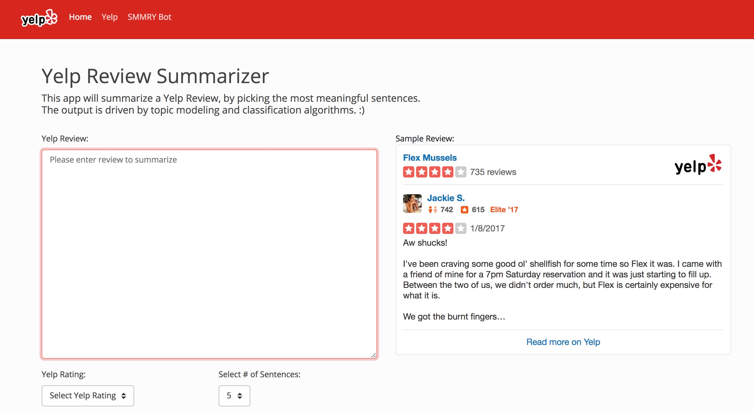
Flask App
http://127.0.0.1:5000/

Slide 17
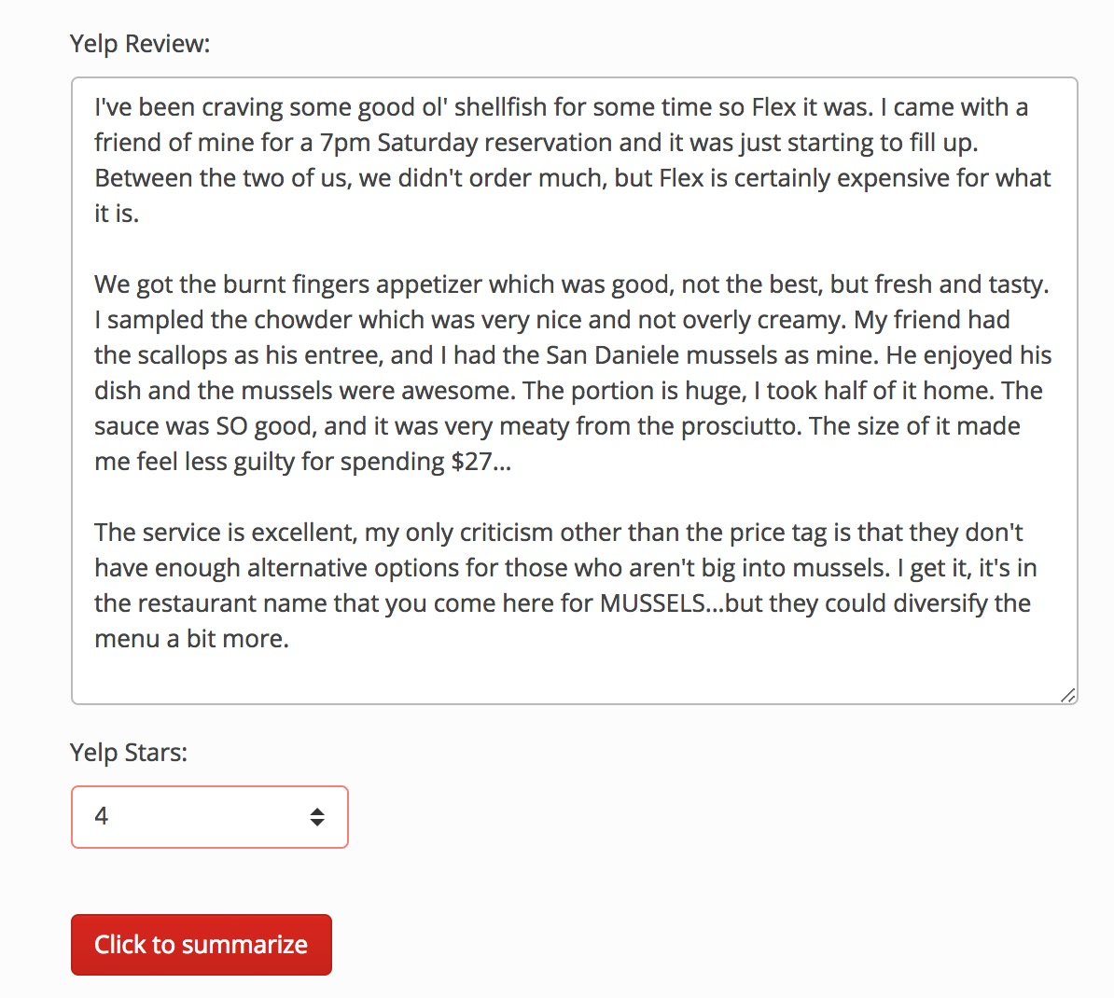
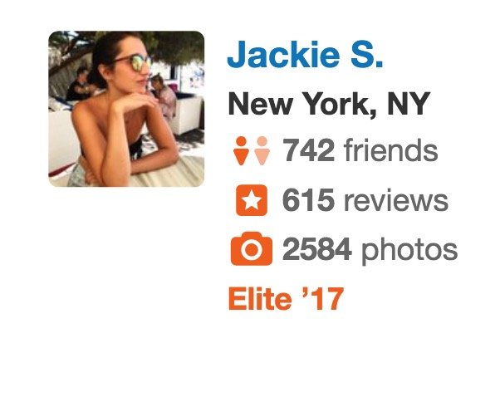
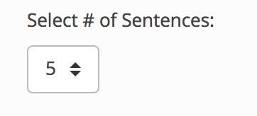
Flask App

Slide 18
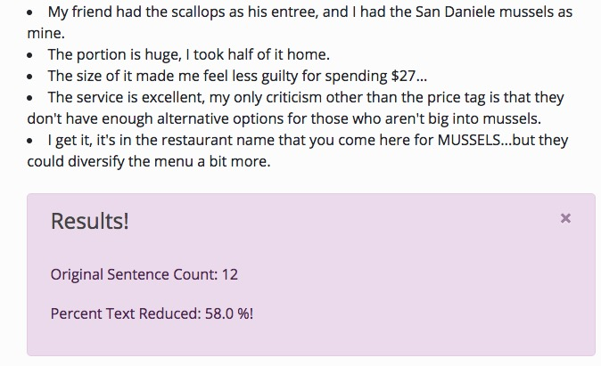
Flask App - Top 5 Sentences

Slide 19
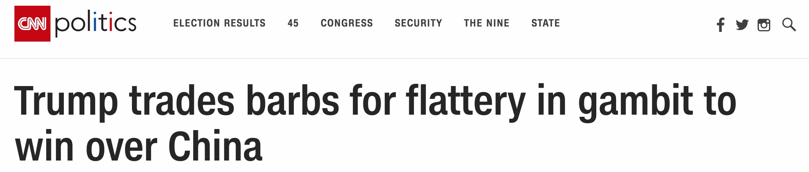
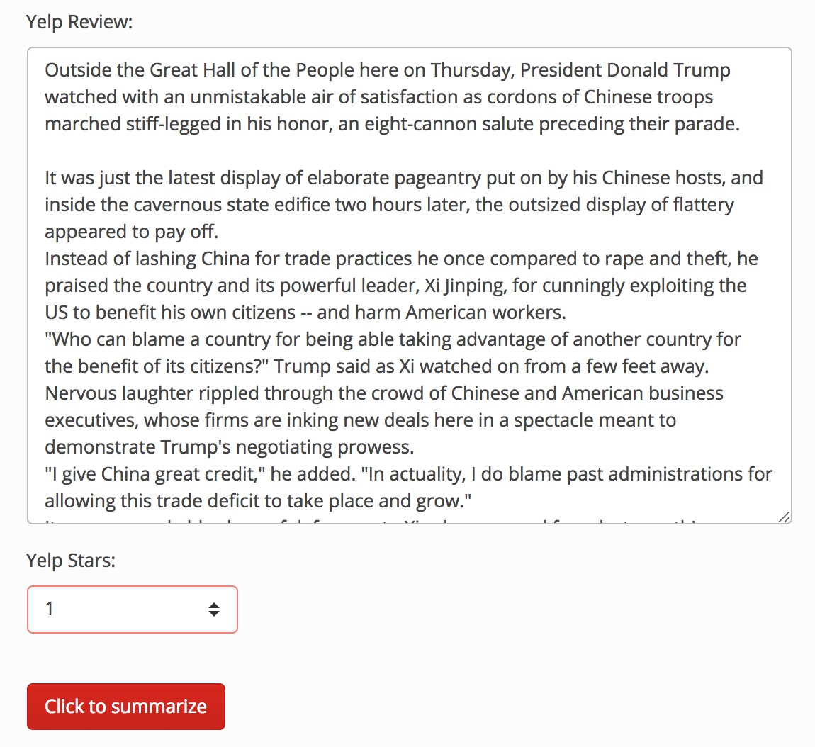
Summary of news article

Slide 20
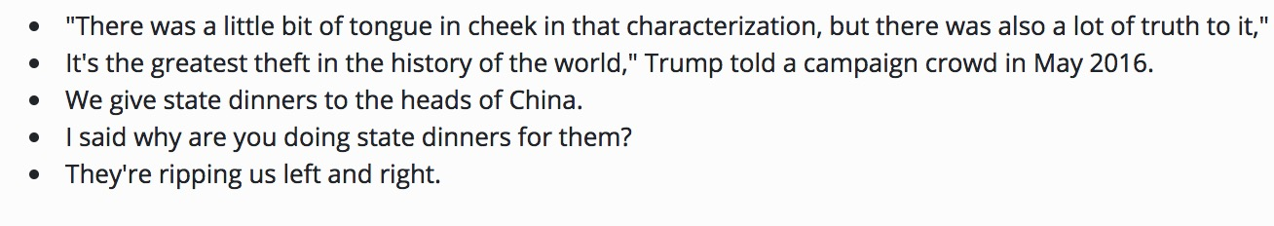
Prediction Model

Slide 21
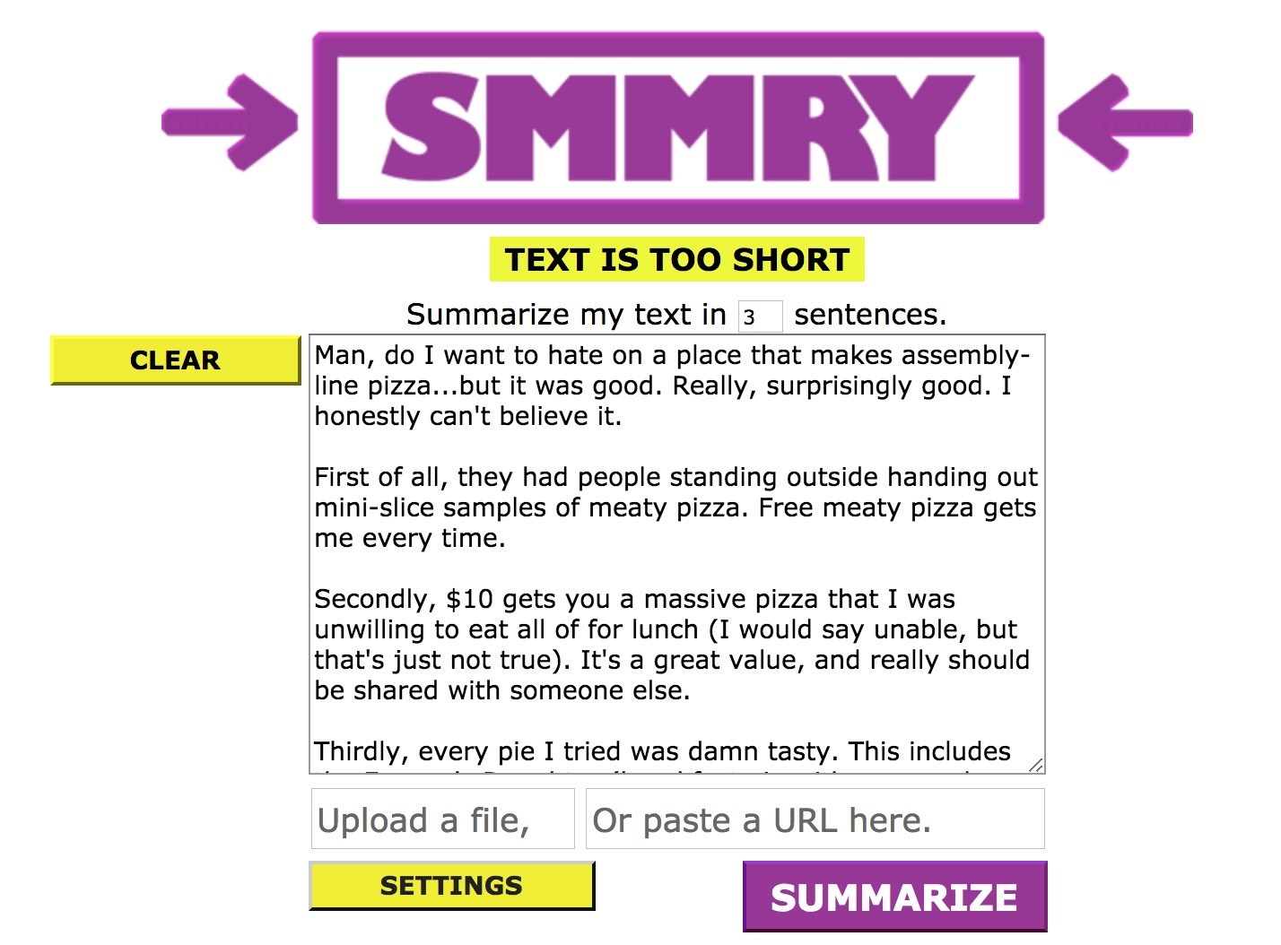
Benchmark 1 - Reddit SMMRY
http://smmry.com/

Slide 22
Benchmark 2 - random sentences
Randomly Chosen:
My only complaint is that there are sooo many tempting ones that don't necessarily go together in terms of flavor profile, but obviously I had to throw them all together on my pizza anyway (but that speaks more to my lack of self-control, so not an actual complaint).
That's how I ended up with a Moonstruck pizza (garlic ricotta, mushroom truffle, mozzarella, mushroom, grilled onion, goat cheese, fig balsamic), which I wasn't actually trying to create--it just ended up having all the toppings I naturally gravitate towards topped with things like pepperoni, Italian sausage, …
Seriously, I have no self control.
It actually ended up tasting delicious, despite some flavor clashes
Unfortunately, I was too full to try their dessert pizza, but you can bet that I'm definitely going to be back!
App Results:
Why did no one tell me that there's a pizza place in New York that sells pizzas at only $10.10 and gives you the option of getting UNLIMITED toppings??
Honestly though, if someone did tell me that, I'd have thought they were pulling my leg.
Seriously, I have no self control.
It was delicious, and I loved how the hot honey was incorporated into savory pizza.
Definitely come check this place out if you like new pizza and soda combinations!

Slide 23
Assumptions
To remove biases in prediction model:
Remove reviews < 6 months history
provide sufficient time for review to get flagged as useful
Remove reviewers with < 3 reviews in data sample
Yelp typically does not show reviews with little history
Remove restaurants < 10 reviews in data sample
reduce the chance of new business
Remove reviews with < 10 sentences
model will be typically be applied to >= 10 sentences
sentences

Slide 24
LDA Topics and top words
Topic 1: Food
like cheese said serve meat sandwich start big offer
Topic 2: Service
table love wait definite seat minute sweet just recommend
Topic 3: Flavor
great night place meal bar portion spicy however doe wine worth
Topic 4: Dinner
come want try make time went bit dinner day restaurant sure
Topic 5: Service
good food service menu friend think price lunch better very
Topic 6: Drink
did look time ask say always like drink bad end actual waitress
Topic 7: Food
place review locate bread need new rice check tri option hot
Topic 8: Quality
just thing dish taste dessert like pork any soup year fresh quality
Topic 9: Food
perfect way cook another hour everything taste use happy
Topic 10: Experience
order very came little experience enjoy small amazing staff server
Topic 11: Flavor
really only because good pretty food flavor star like people before
Topic 12: Atmosphere
got best nice eat delicious roll differ lot expect custom atmosphere

Slide 25
Logistic Regression Model
Feature | Description | Coeff
LDA_1 | Topic - Food | -0.35
LDA_2 | Topic - Service | 0.31
LDA_3 | Topic - Flavor | -0.66
LDA_4 | Topic - Dinner | 1.86
LDA_5 | Topic - Service | -1.66
LDA_6 | Topic - Drink | 0.07
LDA_7 | Topic - Food | 1.10
LDA_8 | Topic - Quality | -0.2
LDA_9 | Topic - Food | 1.02
LDA_10 | Topic - Experience | -2.25
LDA_11 | Topic - Flavor | -0.84
sent_cnt | # Sentences in Review | 0.05
user_stars | Rating Given | -0.02
elite_prior | Reviewer was Elite in past | 1.20
polarity | Avg Polariity / Sentiment | -0.75
Pos (+) Coeff
more likely to be Useful as
variable increases
Neg (-) Coeff
more likely to be NOT Useful as
variable increases

